Slide 1
Excretion & Kidney
https://teachmephysiology.com/urinary-system/nephron/
IGCSE Biology
Notes:
Aquatic animals excrete waste in the form of ammonia, while birds and insects excrete mainly uric acid. Humans produce urea as the major excretory product.

Slide 2
Question list - Part I
1. a) Name two excretory products in human body.
b) How are they excreted out of body?
c) Name one excretory products in plants. How is it excreted out of plants?
2. State components of human urinary system.
3. Functions of kidneys?
4. a) Describe kidney structures, limited to cortex, medulla, pelvis and ureter. (e.g. position?)
b) What is the functional unit of a kidney? What is a glomerulus?
5. How do you understand “blood filtered by kidneys”?
6. a) Where does filtration occur?
b) What substances are filtered out?
7. a) Where does reabsorption occur?
b) What substances are reabsorbed? Into where? To what extent are they reabsorbed?
c) How are they reabsorbed? (diffusion, osmosis, active transport?)
d) Why do we call it a selective reabsorption process?
e) What is a collecting duct?

Slide 3
Question list - Part II
8. Can you think of a way to increase efficiency of reabsorption process?
9. a) When will you produce concentrated urine in small volume? Give 2 scenarios.
b) What will affect concentration and volume of urine?
c) What hormone is involved in adjusting amount of urine?
10. a) What is kidney dialysis? When do you need kidney dialysis?
b) How frequently usually is kidney dialysis required?
11. Describe the general process of kidney dialysis.
12. What measures are taken to increase efficiency of the dialysis? Suggest 3.
13. Advantages of kidney transplant, comparing to kidney dialysis.
Disadvantages/ problems of kidney transplant.

Slide 4
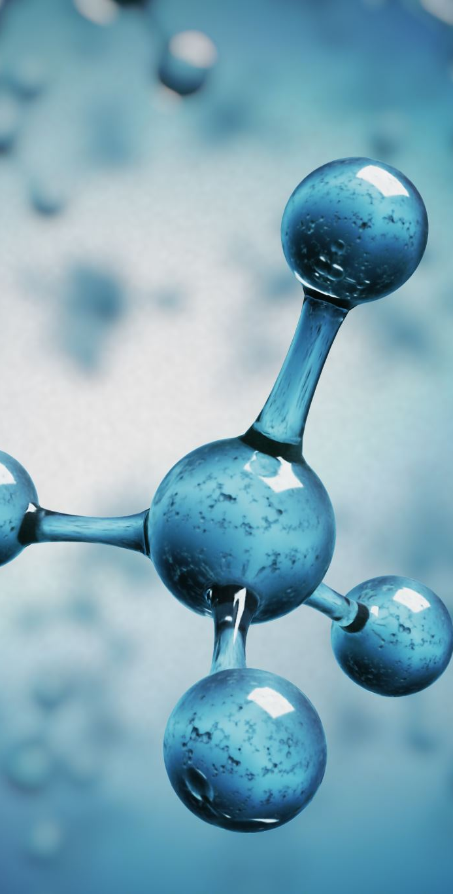
Excretion - definition
Excretion is the removal from organisms of:
the waste products of metabolism (chemical reactions in cells - including respiration). For example, urea and carbon dioxide (which is excreted through the lungs).
substances in excess of requirements. For example, salts.
toxic materials.

Slide 5
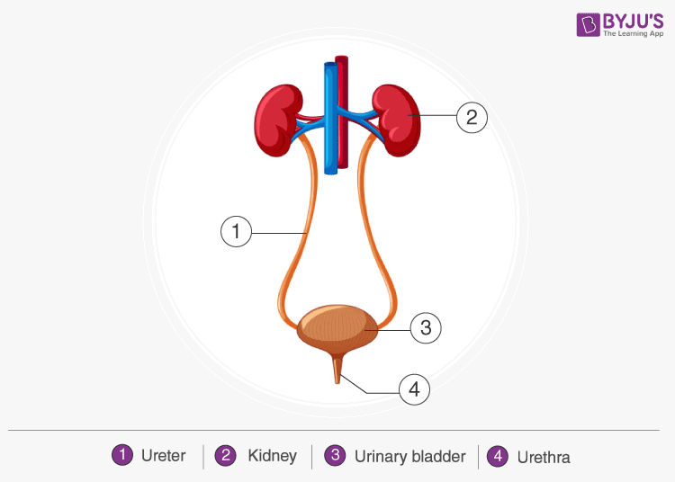
Human urinary system

Slide 6
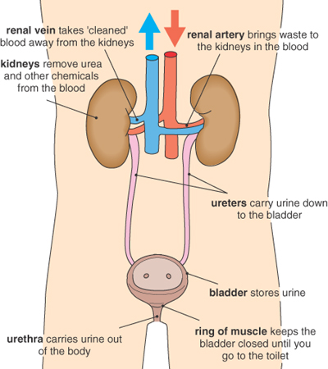
The urinary system
Waste chemicals like urea diffuse from cells into the blood and are transported to the kidneys.
Blood enters the kidneys through the renal arteries.
Blood leaves the kidneys through the renal veins.

Slide 7
The kidneys
The main functions of the kidneys is:
removal of wastes like urea (formed in the liver from excess amino acids) and excess water and salts/ (i.e. filter blood)
maintain/ regulate salt balance and water balance
The kidneys do this by
ultrafiltration and
selective reabsorption of glucose and some salts.

Slide 8
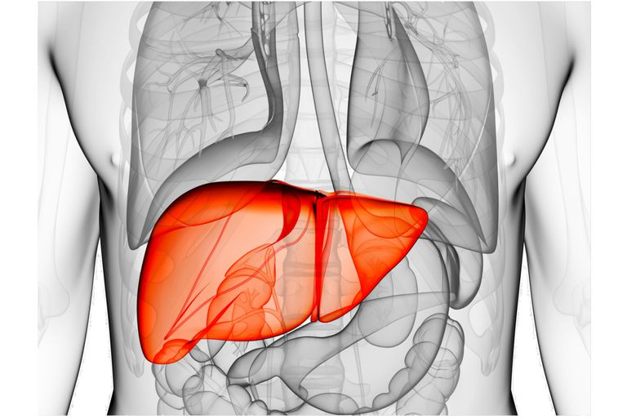
The liver
Urea is formed in the liver from excess amino acids.
Deamination is the process which involves removal of the nitrogen containing part of amino acids to form urea.
Amino acids can be converted in the liver to proteins, including plasma proteins, such as fibrinogen.
Liver also:
Make bile
Help regulating blood glucose level
Store carbs as glycogen in liver
Detoxify, e.g. alcohol
Break down wornout RBCs, hormones, drugs, etc.
Make cholesterol, which is an important component of cell membranes.

Slide 9
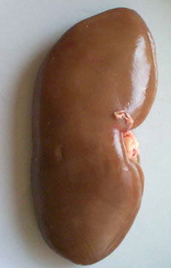
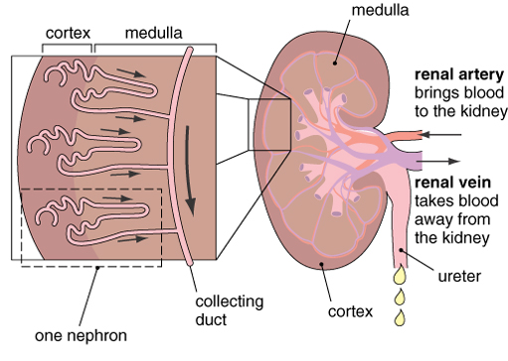
The kidneys
From outside to inside: cortex, medulla, pelvis
Inside each kidney are a large number of nephrons.
Each is made of a glomerulus and a tubule (including Bowman’s capsule, Loop of Henle, PCT and DCT.
PCT: Proximal convoluted tubule
DCT: Distal convoluted tubule (NOT required)
Notes:
Henle’s loop has an ascending and a descending limb. The ascending loop continues as a distal convoluted tubule. The distal convoluted tubules of many nephrons open into the collecting duct.

Slide 10
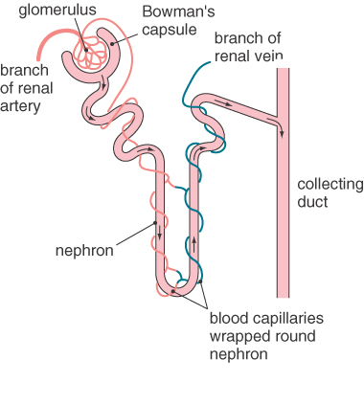
The nephron
Each nephron is well supplied with blood capillaries.
The glomerulus is a network of capillaries surrounded by the Bowman’s capsule. This is where substances are filtered out of the blood plasma (ultrafiltration).
(Glomerulus consists of a bunch of capillaries formed by afferent arterioles. Blood from glomerulus is carried away by efferent arterioles.)
Notes:
The glomerulus is a loop of capillaries twisted into a ball shape, surrounded by the Bowman’s capsule. This is where ultrafiltration of blood occurs, the first step in urine production.
Ultrafiltration occurs when fluid passes across a semipermeable membrane (a membrane that allows some substances to pass through but not others) due to a driving pressure.
The efferent arteriole leads off to form the rest of the nephron.
An average of six nephrons drains into a collecting duct (sodium reabsorption, secrete potassium, absorb water, acid-base balance, transport urine). Kidney stones may form within the collecting ducts of the kidneys.

Slide 11
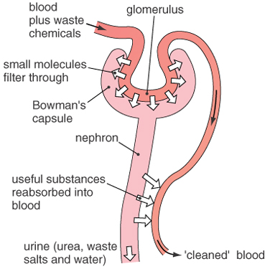
The kidneys
As the blood flows through these tubules, small molecules such as glucose, salts, water and urea are forced out of the blood plasma to form a fluid called filtrate.
As the filtrate passes along the tubule, the useful substances (glucose, salts, water) are reabsorbed into the blood.
Notes:
the afferent and efferent arterioles are responsible for generating pressure. The afferent arteriole (at the proximal glomerulus) dilates, while the efferent arteriole (at the distal glomerulus) constricts. This creates a pressure gradient throughout the glomerulus, causing filtration under pressure.
The filtration rate of molecules of the same charge across the filtration barrier is inversely related to their molecular weight. Small molecules like glucose (180 Da) are freely filtered whereas albumin (69 kDa) is barely able to cross the barrier. The electrical charges on molecules also play a role in affecting their filtration rate. Negatively charged large molecules filter less easily than positively charged ones of the same size.

Slide 12
Amount of urine
The volume of water reabsorbed depends on the body’s water content.
If you are dehydrated, the kidneys will reabsorb more water, so you produce a concentrated (yellow) urine.
If you are not dehydrated, they will reabsorb less water, so you will produce a dilute (pale) urine.

Slide 13
Amount of urine
The volume and concentration of urine is affected by:
water intake – how much water you drink
temperature – hot or cold conditions?
exercise – the more you exercise, the more you will lose water by sweating – so the volume of urine will decrease and the concentration increase.

Slide 14
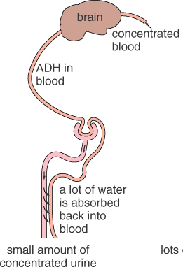
Amount of urine
ADH (Antidiuretic Hormone)
This is produced by hypothalamus in the brain, then stored in the nearby pituitary gland, and travels to the kidneys for use.
ADH controls how much water is reabsorbed.
Q: What will brain react if it senses dilute blood?

Slide 15
Summary – what happens where?
Part of the kidney | Functions
Glomerulus/ Capsule (in the cortex) | Filtration of water, glucose, urea and salts from the blood
Tubule (in the medulla) | Reabsorption of all glucose, most of the water and some salts back into the blood. This leads to concentration of urea in the urine as well as loss of excess water and salts.

Slide 16
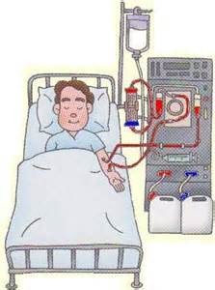
Kidney dialysis
and
Kidney transplants

Slide 17
Kidney dialysis- Introduction
Damage to the kidneys, e.g. through infection or after an accident, can stop the nephrons working properly.
The body can no longer control the amount or composition of urine.
Death may result if kidney failure is not treated.
Kidney dialysis is one type of treatment.
Dialysis involves the separation of two fluids by a partially permeable membrane.
The dialysis membrane has tiny pores (holes) in it which allow water and small solutes to diffuse through, but not larger molecules such as proteins.
Notes:
In hemodialysis, fluid is removed by ultrafiltration using the dialysis membrane. The pressure on the dialysate side is lower so water moves from the blood (place of higher pressure) to the dialysate (place of lower pressure).

Slide 18
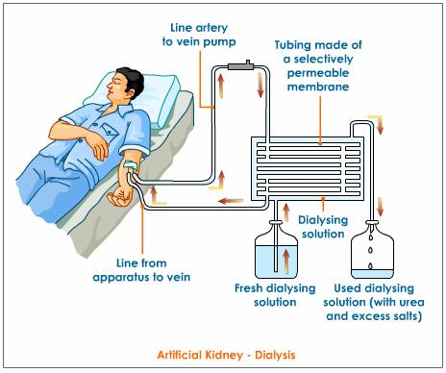
Kidney dialysis

Slide 19
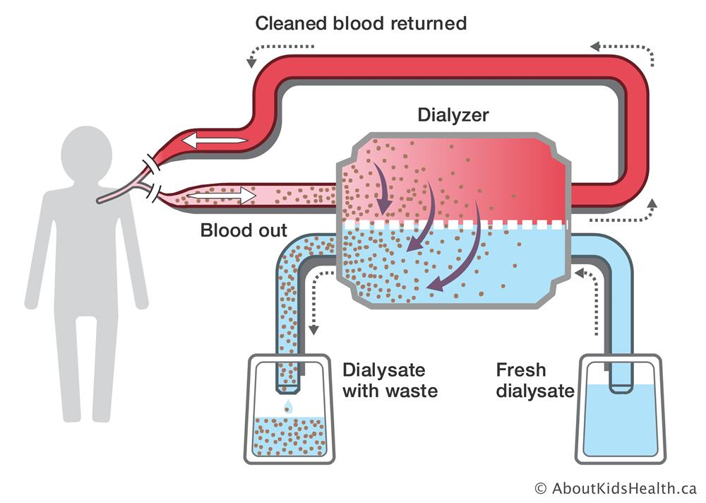

Slide 20
Kidney dialysis – The process
This is what happens when someone has dialysis treatment:
A tube is connected to one of the patient’s veins. (make blood access, e.g. arteriovenous/ AV fistula)
The blood flows along the tube and into the dialysis machine.
Inside the machine the blood is pumped over the surface of a dialysis membrane (a partially permeable membrane), which separates the patient’s blood and the dialysis fluid (dialysate) which has the same concentrations of glucose and salts (Na⁺, Ca²⁺, K⁺, Mg²⁺, Cl⁻, HCO₃⁻ etc.) as normal plasma.
Notes:
fistula, an abnormal or surgically made passage between a hollow or tubular organ and the body surface, or between two hollow or tubular organs.
Arteriovenous fistulas are often surgically created for use in dialysis in people with severe kidney disease.
An arteriovenous (AV) fistula is an abnormal connection between an artery and a vein.
With an arteriovenous fistula, blood flows directly from an artery into a vein, bypassing some capillaries. When this happens, tissues below the bypassed capillaries receive less blood.

Slide 21
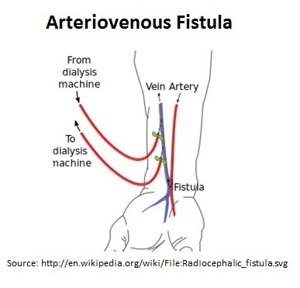
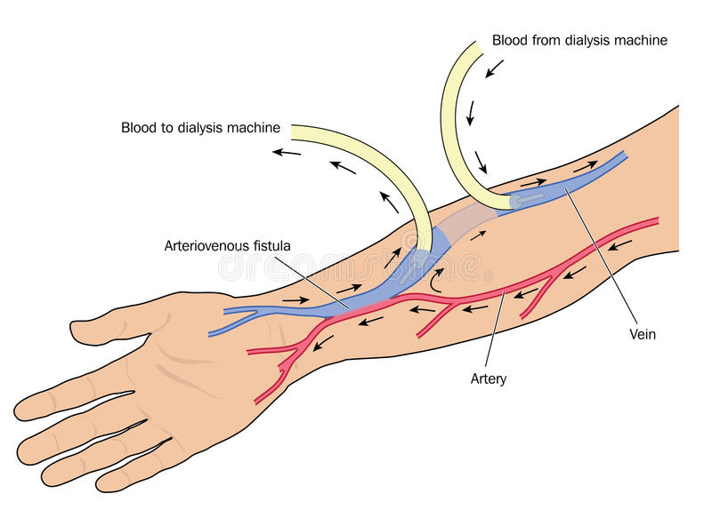
https://kidneypedia.net/dialysis-fistula/
https://www.mayoclinic.org/diseases-conditions/arteriovenous-fistula/symptoms-causes/syc-20369567#:~:text=Arteriovenous%20fistulas%20usually%20occur%20in%20the%20legs%2C%20but,arteriovenous%20fistula%20if%20you%20have%20one%20for%20dialysis.
Notes:
Many times a nephrologist will schedule this surgery many months before he anticipates you will need to go on permanent hemodialysis. This is because an AV Fistula takes several months to “mature” and be ready for use. If you are already on hemodialysis, you will need another form of access until your AV Fistula matures.
A surgical procedure, done in the operating room, is required to stitch together two vessels to create an AV fistula. The access point must be durable enough to withstand dialysis treatment several times a week without collapsing.

Slide 22
Kidney dialysis – The process
(Small size substances are squeezed out of capillaries and into the capsule.)
Urea moves out of the blood, across the dialysis membrane and into the dialysis fluid.
The dialysis fluid already contains normal concentrations of glucose and salts, so there will be no overall loss of glucose from the blood into the fluid.
Protein molecules are too large to move through the dialysis membrane.
During dialysis excess salts, urea and other waste substances are squeezed out of the blood and into the dialysis fluid.
The patient’s ‘cleaned’ blood passes back into the vein.

Slide 23
Kidney dialysis

Slide 24
Kidney dialysis
The patient has to use the machine for several hours, two or three times a week.
This may take place in a hospital, but it can be done at home.
Patients have to eat a special diet without too much protein or salt. (have diet restrictions)
If they eat too much protein, they will produce too much urea, which will become toxic and would mean more frequent dialysis treatment.

Slide 25
Kidney transplants
A person with failed kidneys may have a kidney transplant.
This involves replacing the diseased kidney with a healthy one from a donor.
A donor may be a close relative or friend or someone who has just died.
Blood groups and tissue types of donor and recipient are carefully matched to reduce the chance of rejection by the immune system.

Slide 26
Kidney transplants
Advantages | Disadvantages
More convenient than dialysis as it does not involve frequent treatment sessions. | Finding a suitable donor can be difficult.
The patient is able to lead a more normal/ high quality life. | The risk of tissue rejection is a big problem and can be fatal.
Transplants replace all the normal kidney functions, not just some of them. Less pain (which exists during interdialysis) . | The patient needs to take immunosuppressant for the rest of life and is more likely to suffer from infections.

